Slide 1


Smart Menu Solution Project Evaluation Schemes

Slide 2


Contents
1. Introduce
2. Hardware study
3. Software study
Existing System
Scope
Operation principle
Idea

Slide 3

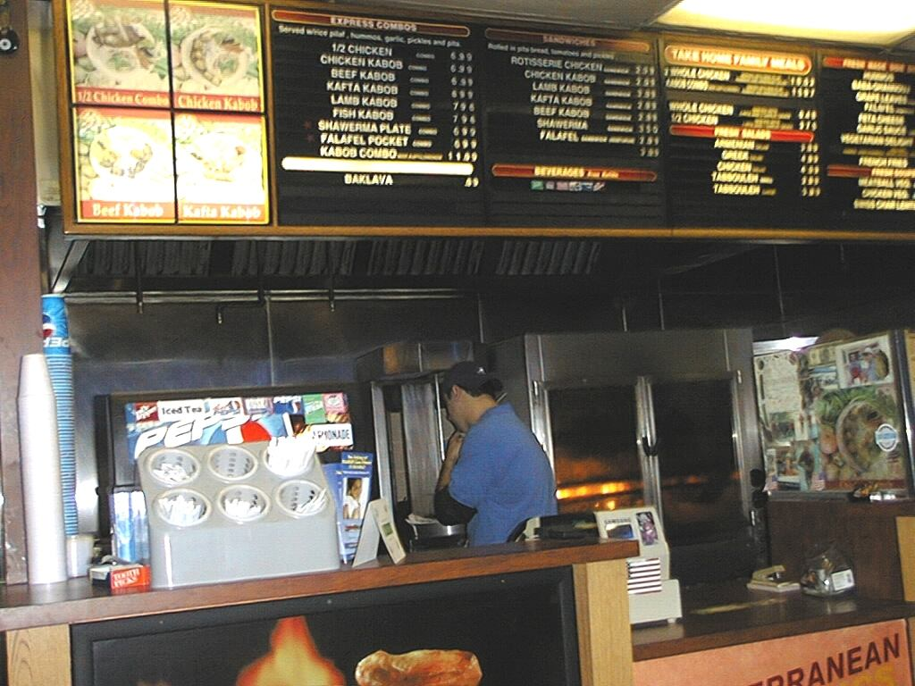

Introduction
Idea
Waste time

Slide 4




Introduction
Idea
Costly
Redundancy

Slide 5
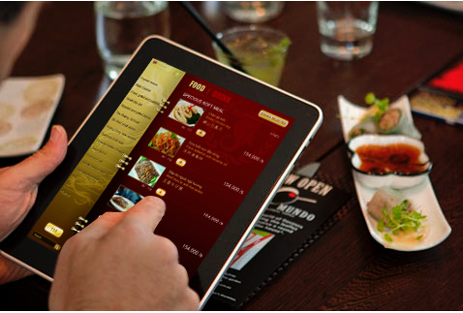
Introduction
Existing System
iMenu
Bach Hop company (BICWeb.VN).
Choosing dishes thought IPAD or another tablet.
http://www.bicweb.vn

Slide 6

Introduction
Existing System
iMenu
iMenu system is installed on server.
Application runs on IPAD/Tablet (Client) thought server.
http://www.bicweb.vn

Slide 7
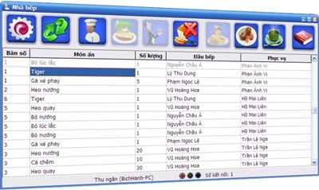


Introduction
Existing System
ezMenu
http://vienphuc.com/ezmproduct.htm

Slide 8
Introduction
Conclusion
Actual needs:
Lost time for waiting to note orders.
Have errors and lead to debate later when notes by papers.
High expense and hard to control a lots waiter.
None of the existing system is widely applied in Viet Nam because:
Price,
Functionality,
Usability, etc.
→ The market is still available for our product.

Slide 9
Introduction
Scope
Provide the basic functions:
Ordering: Provide a new electric device replace a traditional ways in ordering dishes.
Management: Provide a window management software to manage orders, billing, statistic and automatically distribute dishes to chef.
Research & apply formal methods development (Yakindu) into executable embedded system.
Provide a long-term stable system.
Have acceptable price.

Slide 10


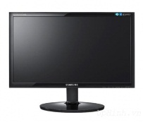


Introduction
Global Picture
Cashier
SMO Device
SMR Device
SMC Device
SMO Device
Kitchen
…
PC Server
SMO: Smart Menu Ordering
SMR: Smart Menu Receiver
SMC: Smart Menu Chef
Printer

Slide 11

Introduction
Product
SMO
SMR
LCD Display
Microprocessor
Keypad
RF module
Radio Signal
RF module
Microprocessor
USB module
Radio signal
USB
RF module
SMC
Microprocessor
Keypad

Slide 12
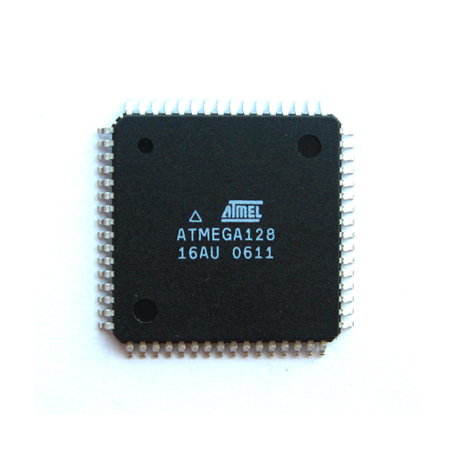
Hard & Soft
Hardware Study
High-performance, Low-power AVR® 8-bit Microcontroller
High Endurance Non-volatile Memory segments
JTAG (IEEE std. 1149.1 Compliant) Interface
Peripheral Features
Special Microcontroller Features
I/O and Packages
Operating Voltages: 4.5 - 5.5V
Speed Grades: 0 - 16 MHz
ATmega128-16AU

Slide 13
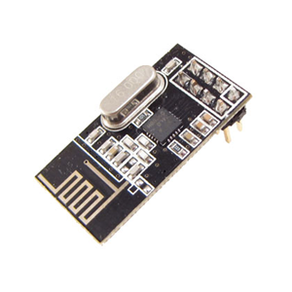
Hard & Soft
Hardware Study
Low cost single-chip 2.4GHz GFSK RF transceiver IC
Worldwide license-free 2.4GHz ISM band operation
1Mbps and 2Mbps on-air data-rate
Enhanced ShockBurst™ hardware protocol accelerator
Ultra low power consumption – months to years of battery lifetime
nRF24L01

Slide 14
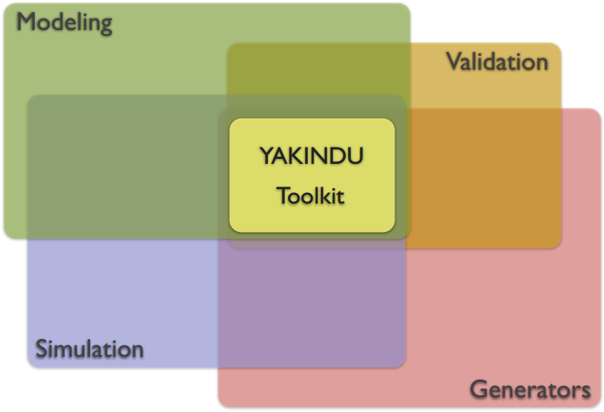
Hard & Soft
Software Study
What is Yakindu?
Yakindu is a modular toolkit for model driven development of embedded systems.
Yakindu is:
Build on Eclipse.
Open source.
Available at Eclipse Labs.
Links:
http://eclipselabs.org/p/yakindu
http://yakindu.org

Slide 15
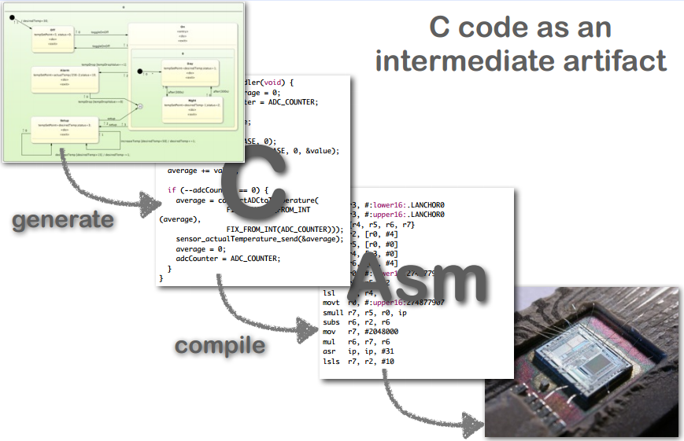
Hard & Soft
Software Study
Model Driven Development (MDD)
Abstraction Levels:

Slide 16
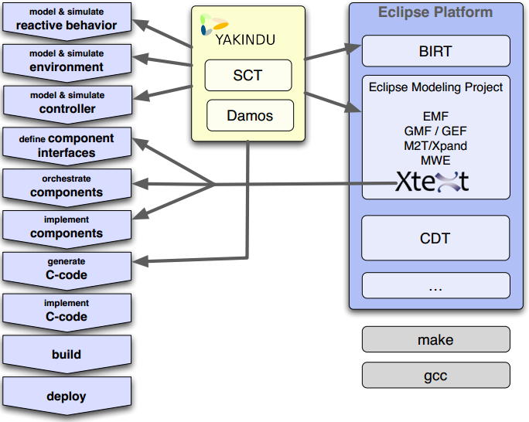
Hard & Soft
Software Study
Activities & Tools

Slide 17
Conclusion
Q&A

Slide 18
Thank you
for your attention!

